Slide 1
Algoritmos y
Estructuras de Datos
Curso 2016

Slide 2
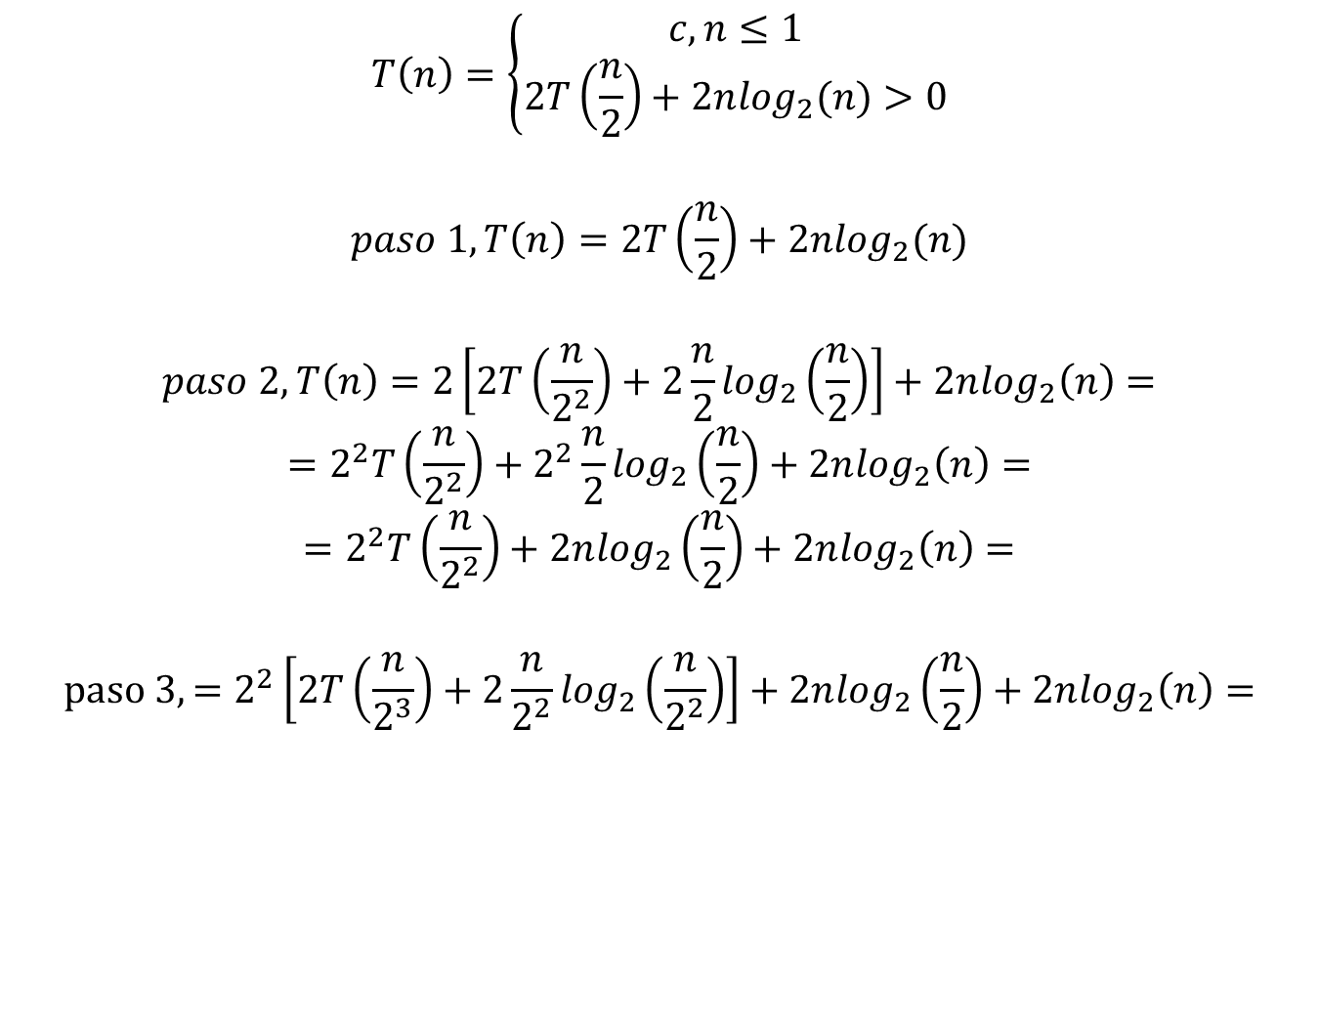
Recurrencia
$$T\left(n\right)=\left\{\begin{matrix}c, n≤1 \\ 2T\left(\frac{n}{2}\right)+2n\log_{2}(n)>0\end{matrix}\right.$$
$$paso 1, T\left(n\right)=2T\left(\frac{n}{2}\right)+2n\log_{2}(n)$$
$$paso 2, T\left(n\right)=2\left[2T\left(\frac{n}{2^{2}}\right)+2\frac{n}{2}\log_{2}\left(\frac{n}{2}\right)\right]+2n\log_{2}\left(n\right)=$$
$$=2^{2}T\left(\frac{n}{2^{2}}\right)+2^{2}\frac{n}{2}\log_{2}\left(\frac{n}{2}\right)+2n\log_{2}\left(n\right)=$$
$$=2^{2}T\left(\frac{n}{2^{2}}\right)+2n\log_{2}\left(\frac{n}{2}\right)+2n\log_{2}\left(n\right)=$$
$$paso 3, =2^{2}\left[2T\left(\frac{n}{2^{3}}\right)+2\frac{n}{2^{2}}\log_{2}\left(\frac{n}{2^{2}}\right)\right]+2n\log_{2}\left(\frac{n}{2}\right)+2n\log_{2}\left(n\right)=$$

Slide 3
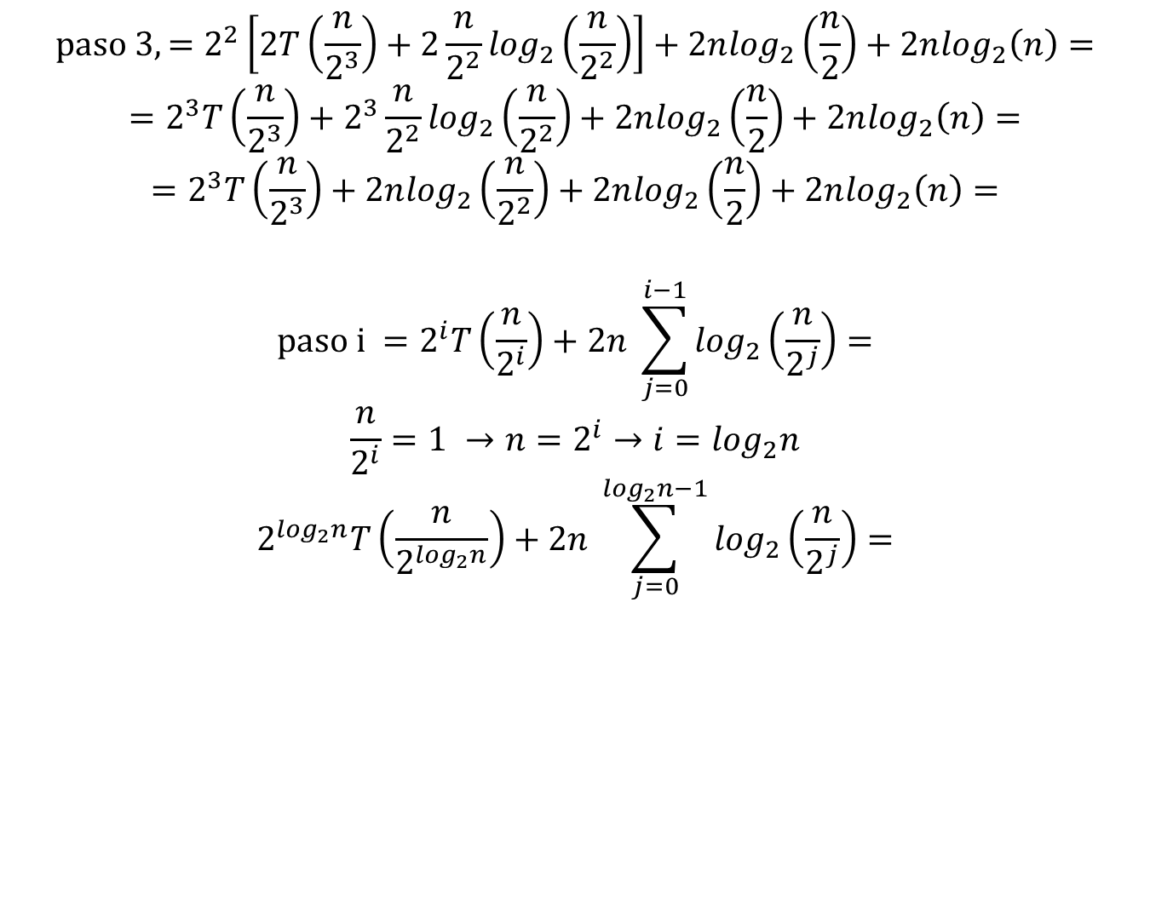
$$paso 3, =2^{2}\left[2T\left(\frac{n}{2^{3}}\right)+2\frac{n}{2^{2}}\log_{2}\left(\frac{n}{2^{2}}\right)\right]+2n\log_{2}\left(\frac{n}{2}\right)+2n\log_{2}\left(n\right)=$$
$$=2^{3}T\left(\frac{n}{2^{3}}\right)+2^{3}\frac{n}{2^{2}}\log_{2}\left(\frac{n}{2^{2}}\right)+2n\log_{2}\left(\frac{n}{2}\right)+2n\log_{2}\left(n\right)=$$
$$=2^{3}T\left(\frac{n}{2^{3}}\right)+2n\log_{2}\left(\frac{n}{2^{2}}\right)+2n\log_{2}\left(\frac{n}{2}\right)+2n\log_{2}\left(n\right)=$$
$$paso i =2^{i}T\left(\frac{n}{2^{i}}\right)+2n \sum_{j=0}^{i−1}{\log_{2}\left(\frac{n}{2^{j}}\right)}=$$
$$\frac{n}{2^{i}}=1 →n=2^{i}→i=\log_{2}n$$
$$2^{\log_{2}n}T\left(\frac{n}{2^{\log_{2}n}}\right)+2n \sum_{j=0}^{\log_{2}n−1}{\log_{2}\left(\frac{n}{2^{j}}\right)}=$$

Slide 4
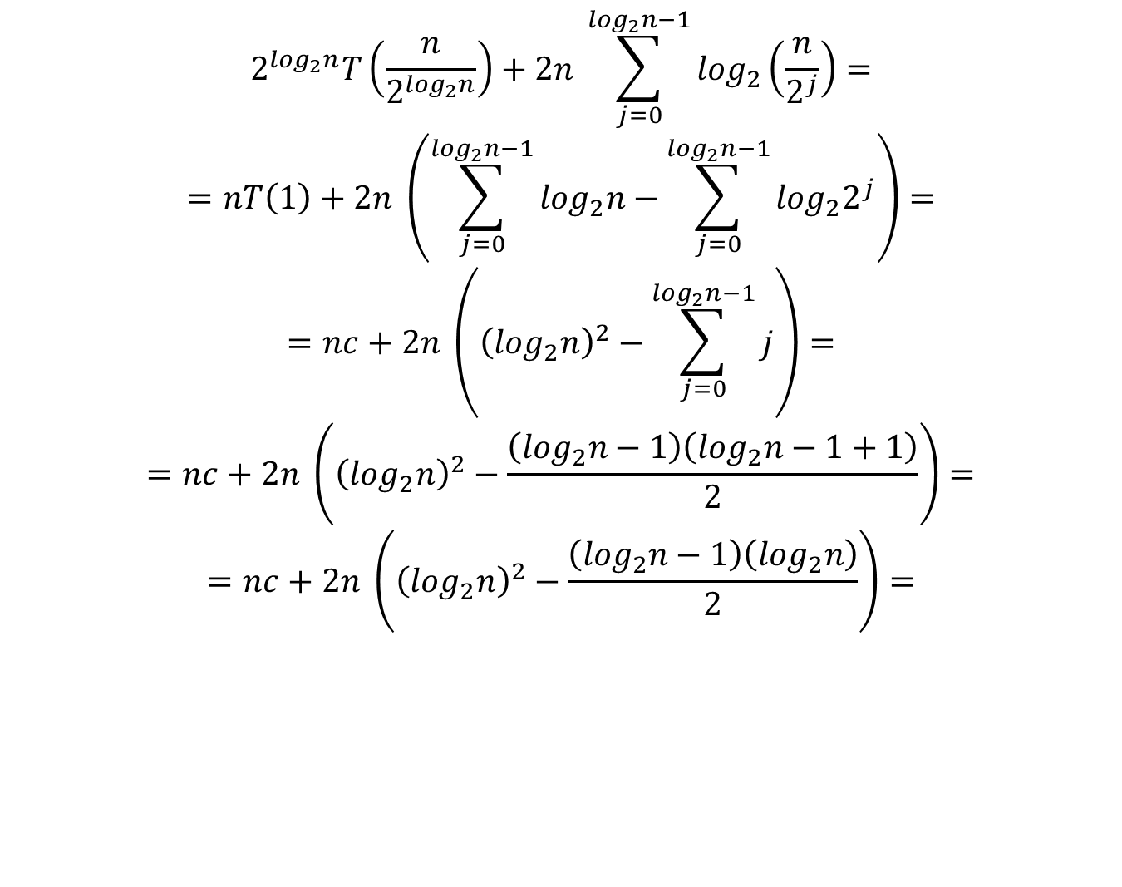
$$2^{\log_{2}n}T\left(\frac{n}{2^{\log_{2}n}}\right)+2n \sum_{j=0}^{\log_{2}n−1}{\log_{2}\left(\frac{n}{2^{j}}\right)}=$$
$$=nT\left(1\right)+2n \left(\sum_{j=0}^{\log_{2}n−1}{\log_{2}n−\sum_{j=0}^{\log_{2}n−1}{\log_{2}2^{j}}}\right)=$$
$$=nc+2n \left({\left(\log_{2}n\right)}^{2}−\sum_{j=0}^{\log_{2}n−1}{j}\right)=$$
$$=nc+2n \left({\left(\log_{2}n\right)}^{2}−\frac{\left(\log_{2}n−1\right)\left(\log_{2}n−1+1\right)}{2}\right)=$$
$$=nc+2n \left({\left(\log_{2}n\right)}^{2}−\frac{\left(\log_{2}n−1\right)\left(\log_{2}n\right)}{2}\right)=$$

Slide 5
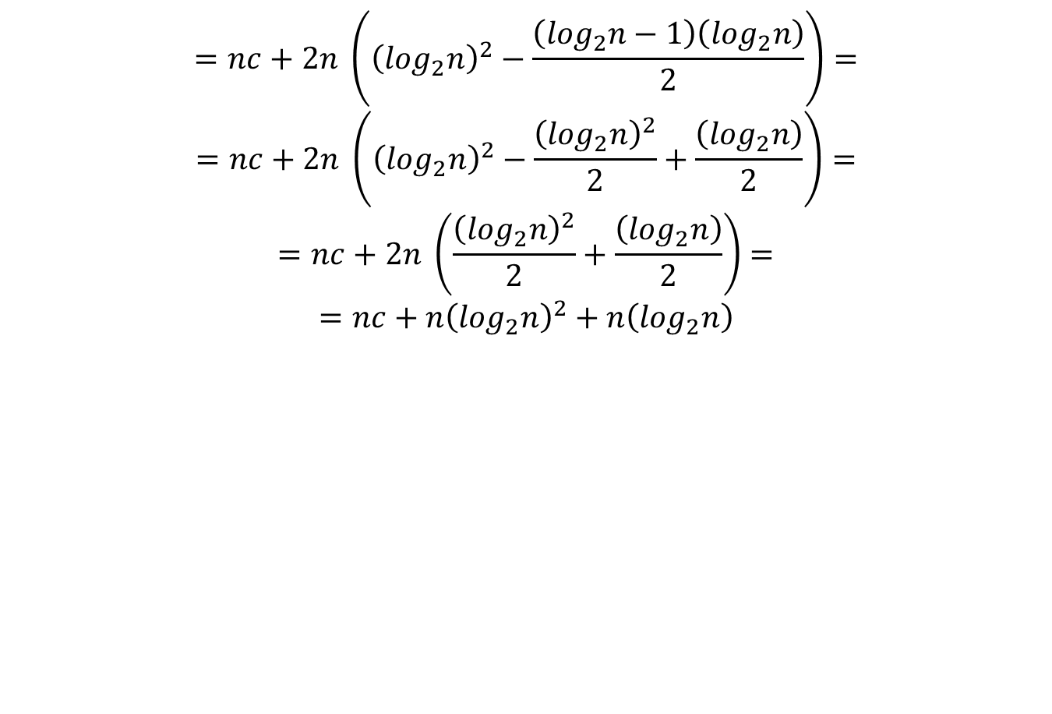
$$=nc+2n \left({\left(\log_{2}n\right)}^{2}−\frac{\left(\log_{2}n−1\right)\left(\log_{2}n\right)}{2}\right)=$$
$$=nc+2n \left({\left(\log_{2}n\right)}^{2}−\frac{{\left(\log_{2}n\right)}^{2}}{2}+\frac{\left(\log_{2}n\right)}{2}\right)=$$
$$=nc+2n \left(\frac{{\left(\log_{2}n\right)}^{2}}{2}+\frac{\left(\log_{2}n\right)}{2}\right)=$$
$$=nc+n{\left(\log_{2}n\right)}^{2}+n\left(\log_{2}n\right)$$

